Slide 1
Zillow Home Value Prediction
Group member:
Young Min kim, Sitao Min, Zi Li

Slide 2
Outline
Task Description
Data Pre-processing
Model Training
Linear Models
Boosted Tree Models
Result Analysis
Conclusion

Slide 3
Task Description

Slide 4
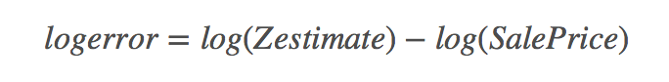
Problem Statement and Data Description
Problem Statement and Data Description
Problem Statement and Data Description
Problem Statement and Data Description
Problem Statement
A Kaggle competition problem
Goal: building a model to predict the log-error between their Zestimates and the actual sale price, given all features of a home.

Slide 5
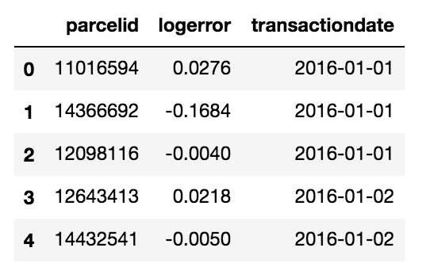
Data Description
A full list of real estate properties in three counties data in 2016 and 2017
2,985,217 properties and 58 features (eg. ‘bedroomcnt’, ‘heatingorsystemtypeid’)
Training data for 2016 including all the transactions before October 15, 2016, plus some of the transactions after October 15, 2016 (90275 rows). Training data for 2017 includes transactions from 1/1/2017 to 9/15/2017 (77613 rows).
The rest transaction data in each year as test data
Predict the log error for 6 time points -
October, November, and December of 2016 and 2017

Slide 6
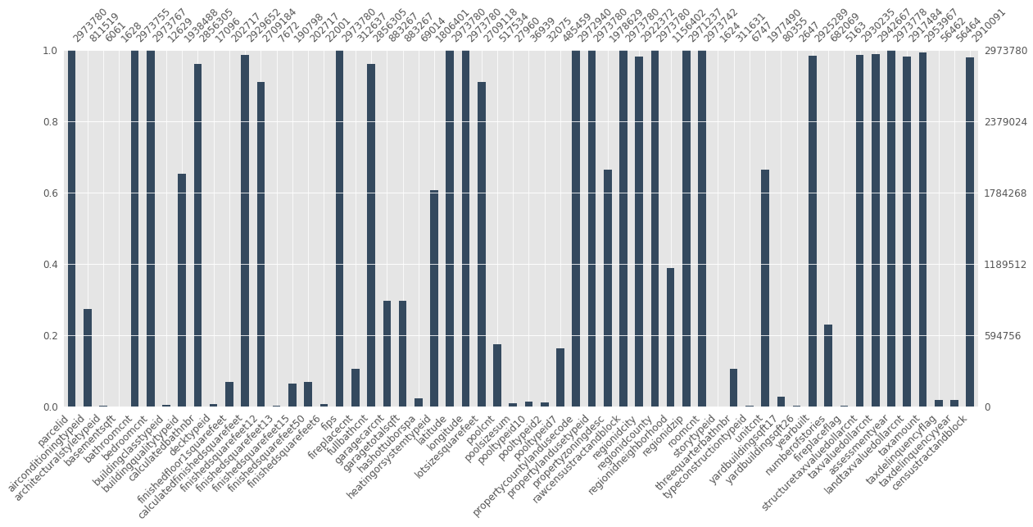
Problem Statement and Data Description
Problem Statement and Data Description
Problem Statement and Data Description
Problem Statement and Data Description
Data Preprocessing
Handling Missing Values
So many missing values!
Many columns has missing rate over 80%.

Slide 7
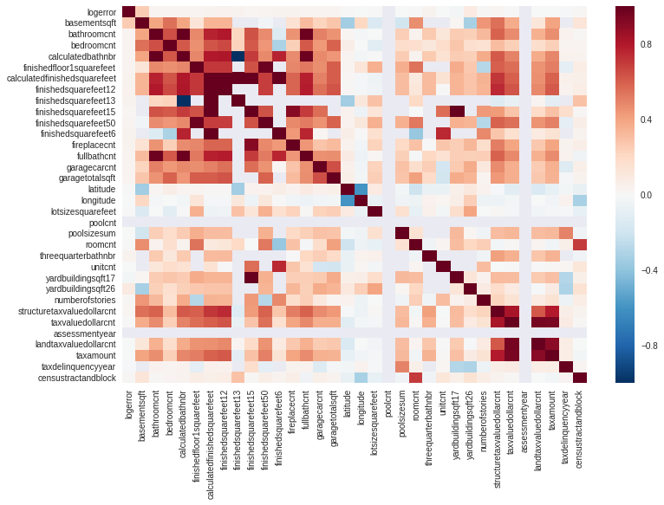
Problem Statement and Data Description
Problem Statement and Data Description
Problem Statement and Data Description
Problem Statement and Data Description
Data Preprocessing
Handling Missing Values
Dropping features:
Drop the column completely if its missing rate is over some threshold (97%)
find a group of strongly-correlated features, keep the one with the fewest missing values and drop the rest, i.e. calculatedfinishedsquarefeet,finishedsquarefeet12, finishedsquarefeet13

Slide 8
Problem Statement and Data Description
Problem Statement and Data Description
Problem Statement and Data Description
Problem Statement and Data Description
Data Preprocessing
Handling Missing Values
Data Imputation:
Simple approach: filling in the missing values their mean, median, or mode
KNN approach: i.e. for features describing geographical information, such as ‘regionidcity’, we can get a KNN value based on longitude and latitude data and fill it in.

Slide 9
Problem Statement and Data Description
Problem Statement and Data Description
Problem Statement and Data Description
Problem Statement and Data Description
Data Preprocessing
Selecting Features
Doing it manually:
Using domain knowledge based on the feature description provided by Zillow, we drop feature with redundant information, such as ’fullbathcnt’ and ’bathcnt.’.
Automatic feature selection:
Using algorithm to select features is probably more reliable. We have tried setting variance threshold, recursive feature elimination (RFE) and build-in feature selection of models like LASSO.

Slide 10
Model Description

Slide 11
Model Description
We tried various models to do the prediction. They fall into the following two classes:
Linear Models:
Linear Regression (OLS)
Ridge
LASSO
Elasticnet
RANSAC + LASSO
RANSAC + Ridge
Boosted Tree Models
XGBoost
LightGBM
DART+LightGBM

Slide 12
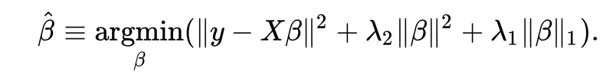
Problem Statement and Data Description
Problem Statement and Data Description
Problem Statement and Data Description
Problem Statement and Data Description
Model Description
Linear Models
Lasso: L1-penalty
Ridge: L2-penalty
Elastic net: Has both L1-penalty and L2-penalty.
Two hyper- parameters: L1 penalty and L1 penalty ratio
Compared to LASSO, it stabilizes the L1 regularization path.

Slide 13
Linear Models —removing outlier
Problem Statement and Data Description
Problem Statement and Data Description
Problem Statement and Data Description
Problem Statement and Data Description
Model Description
RANSAC(Random Sample Consensus)
step1: Sample data randomly
step2: Fitting sampled data
step3: Calculate error point (inlier and outlier)
step4: Iterate above steps until reach threshold number of error points detect

Slide 14
Boosting Tree Model
Xgboost: efficient framework of boosting tree methods
pros: still very slow for personal computer
LightGBM: using two techniques to speed up training boosting tree
GOSS(Gradient one-side sampling): remove samples with smaller gradient
EFB(Exclusive Feature Bundle): bundling features which are similar
DART: (Dropout Additive Regression Tree)
drop out some trees during learning process

Slide 15
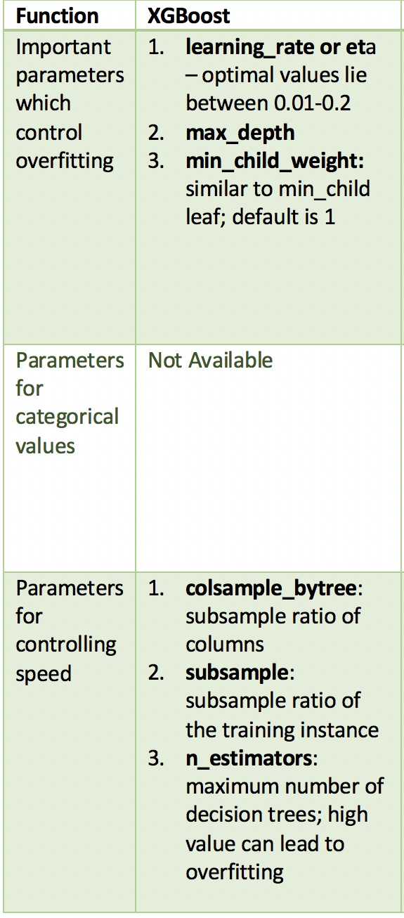
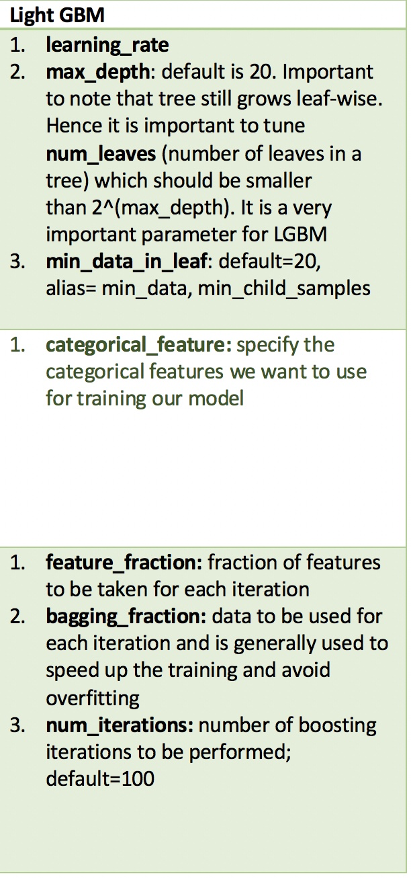
Problem Statement and Data Description
Problem Statement and Data Description
Problem Statement and Data Description
Problem Statement and Data Description
Model Description
Boosted Tree Models
XGBoost and Light GBM have great similarity in hyperparameters. But LightGBM run much faster.
Notes:
outliers, which are e.g. caused by erroneous measurements or invalid hypotheses about the data.

Slide 16
Problem Statement and Data Description
Problem Statement and Data Description
Problem Statement and Data Description
Problem Statement and Data Description
Model Description
Boosted Tree Models
General Approach for Parameter Tuning
Choose a relatively high learning rate. Generally the default value of 0.1 works but somewhere between 0.05 to 0.2 should work for different problems. Determine the optimum number of trees for this learning rate. Choose a value on which your system can work fairly fast. This is because it will be used for testing various scenarios and determining the tree parameters.
Tune tree-specific parameters (max_depth, min_child_weight, subsample, etc)for decided learning rate and number of trees.
Tune regularization parameters (lambda, alpha) to reduce model complexity and enhance performance.
Lower the learning rate and increase the estimators proportionally to get more robust models.

Slide 17
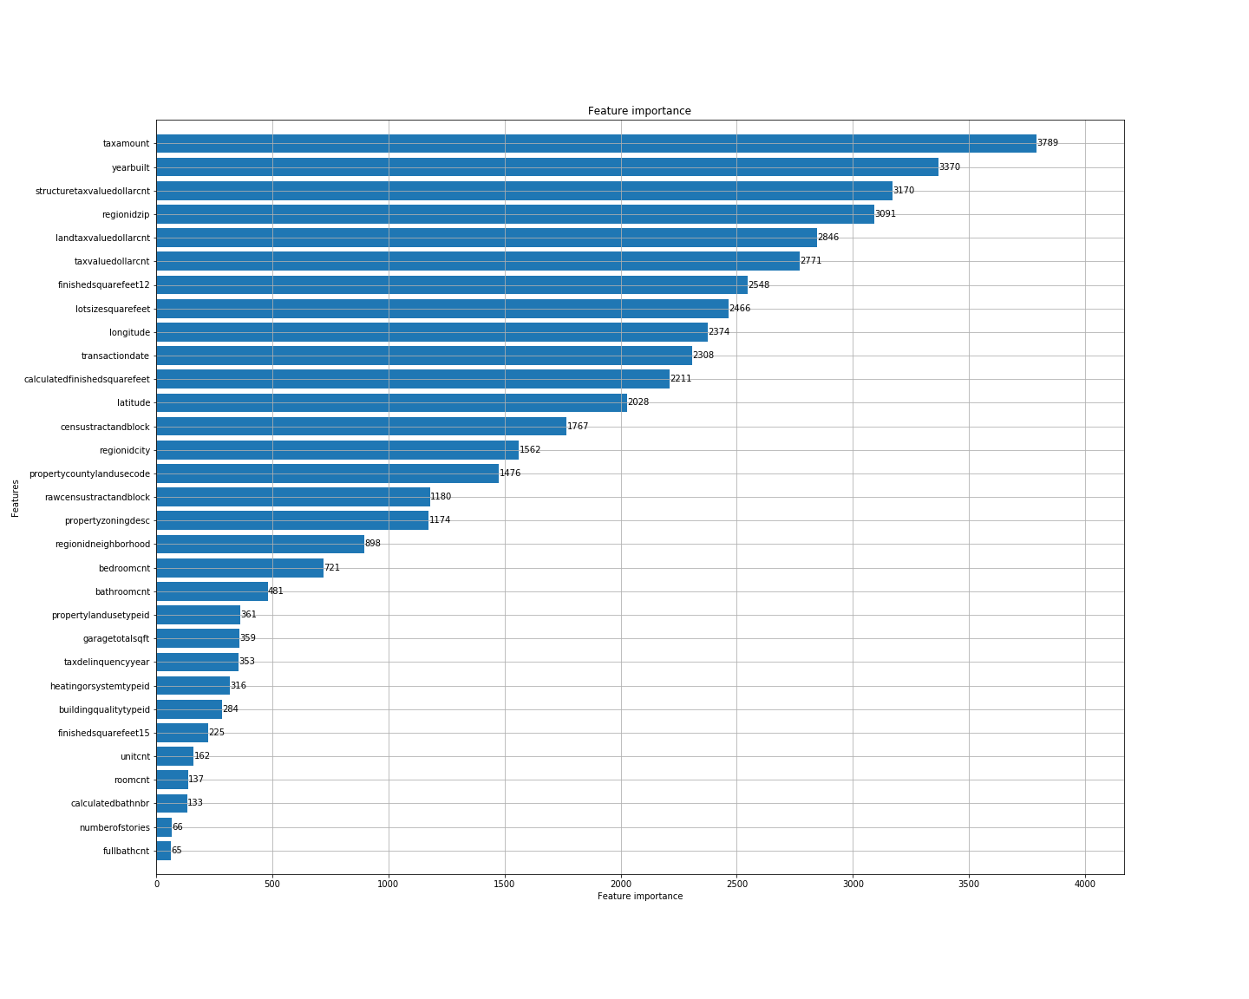
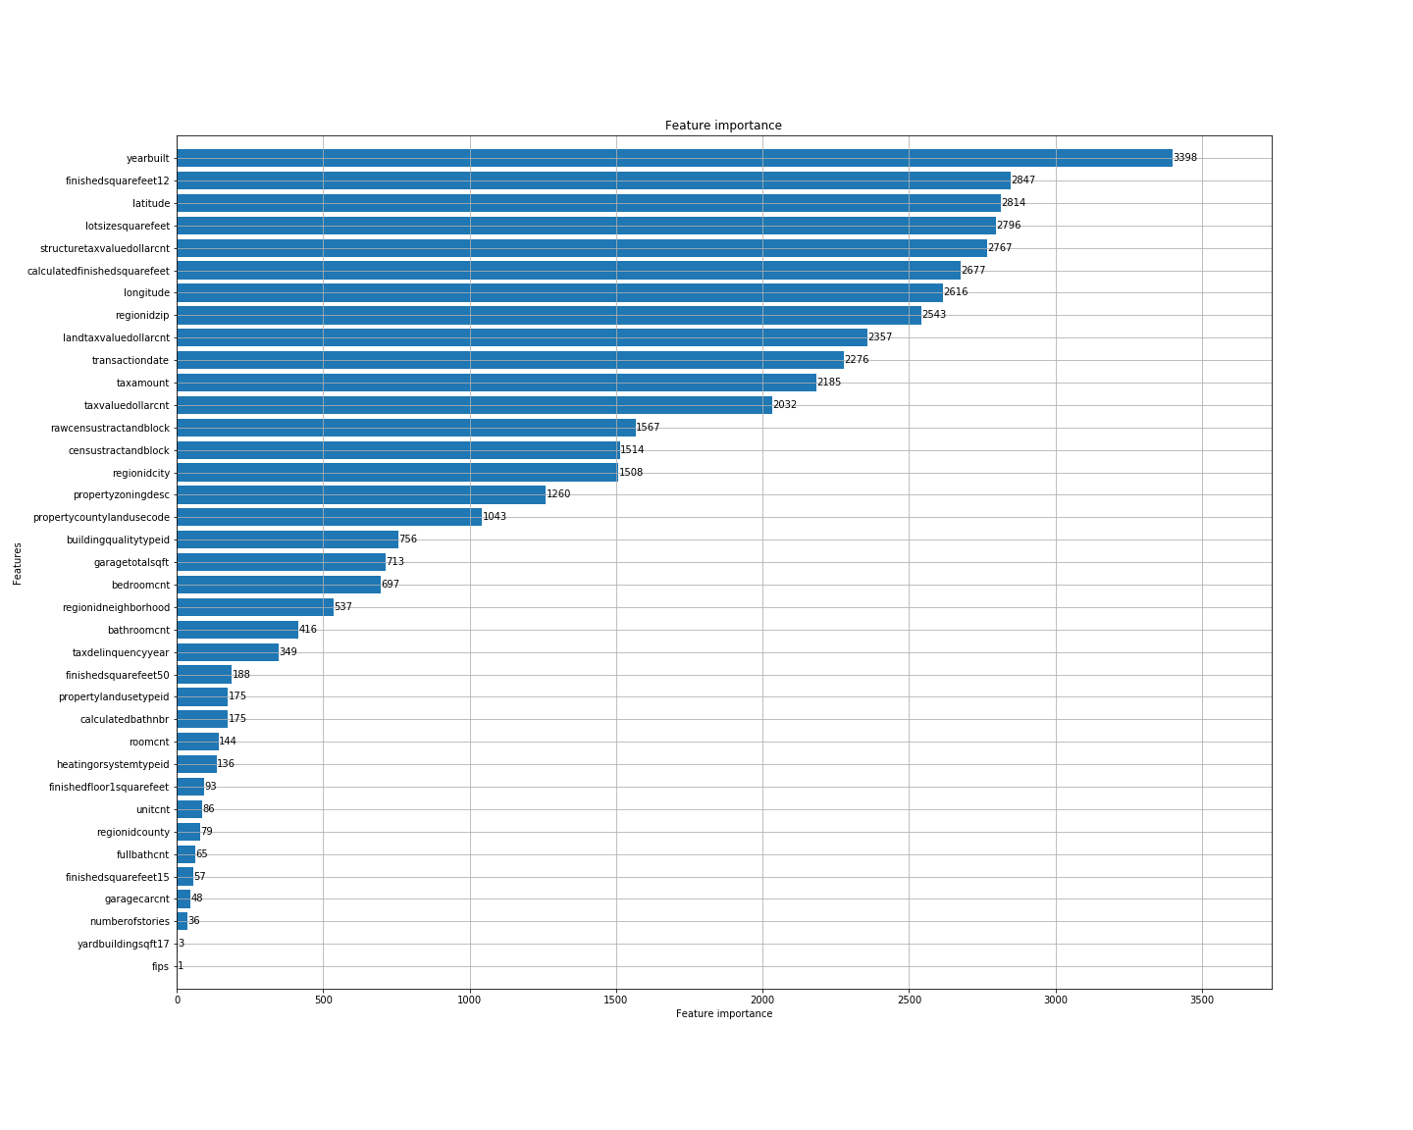
Problem Statement and Data Description
Problem Statement and Data Description
Problem Statement and Data Description
Problem Statement and Data Description
Model Description
Boosted Tree Models – Feature Importance Analysis
2016 Model
2017 Model

Slide 18
Result Analysis

Slide 19
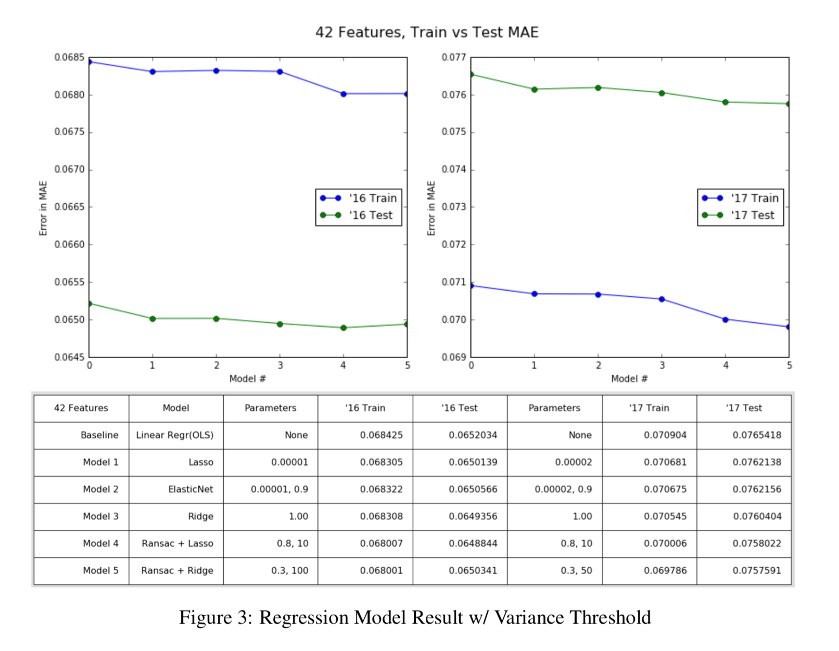
Result Analysis

Slide 20
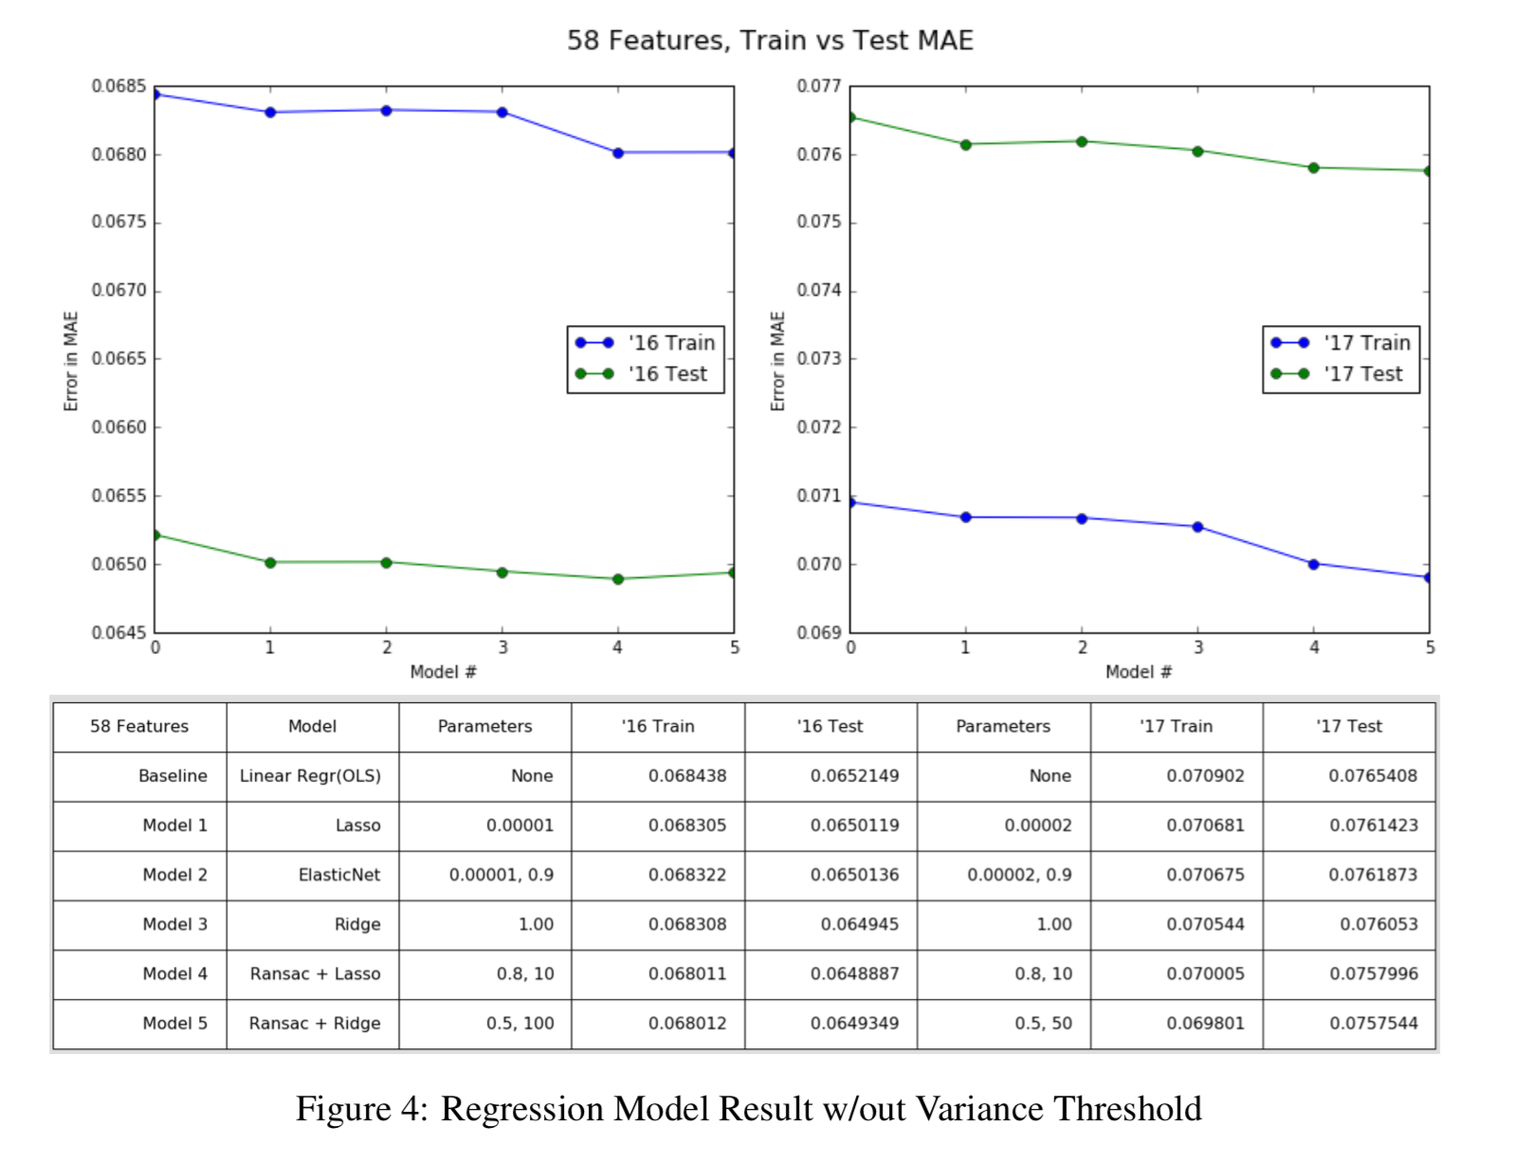
Result Analysis

Slide 21
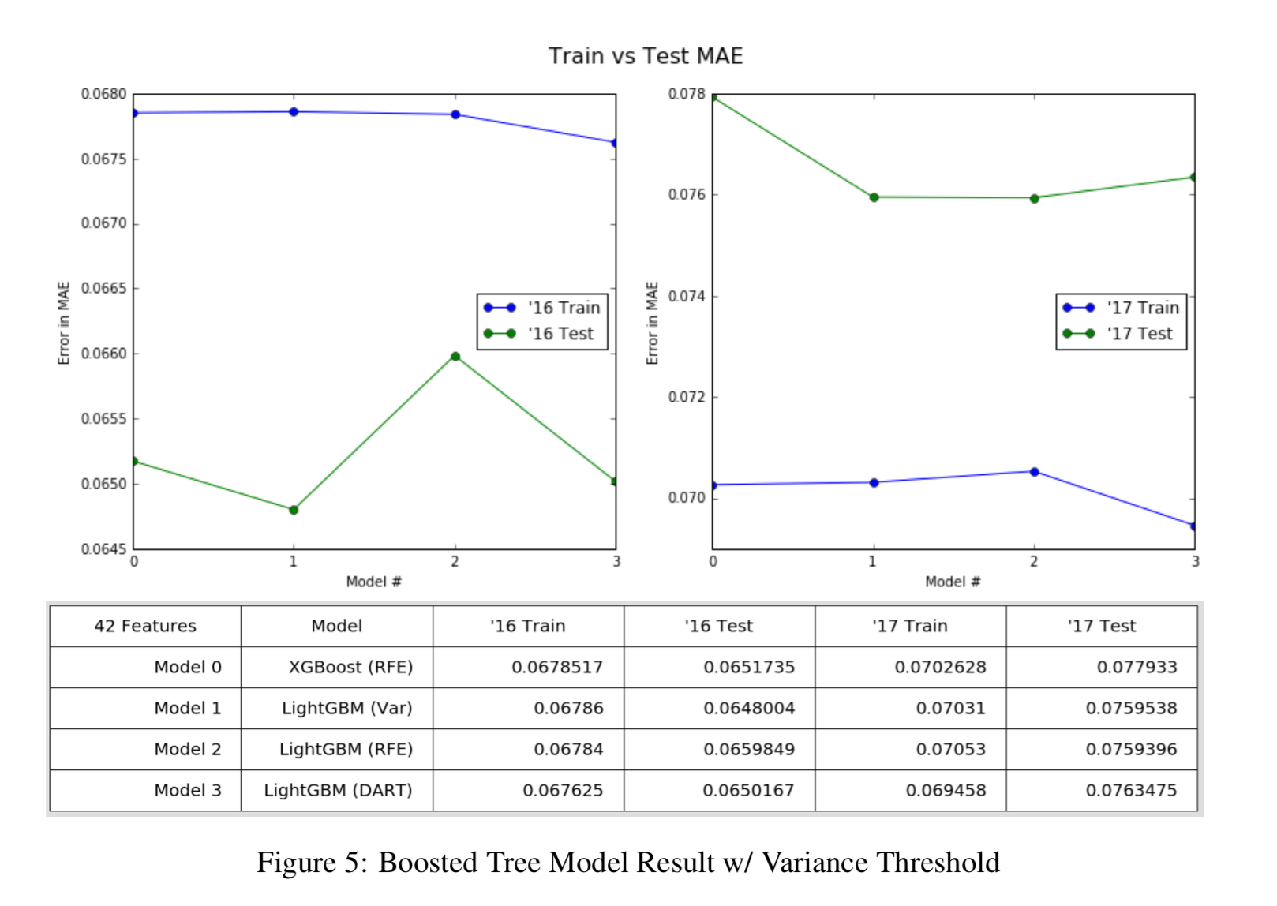
Result Analysis

Slide 22
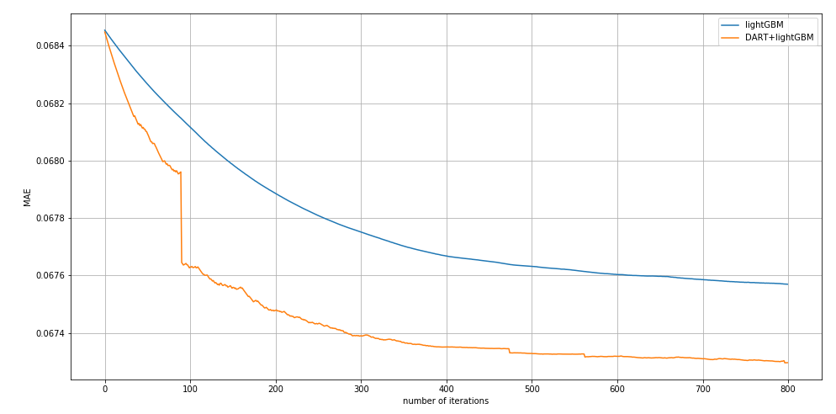
Result Analysis
2016
2017
DART improves training, but the test error is worse (overfitting)

Slide 23
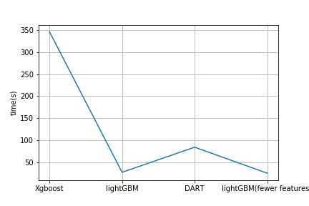
Result Analysis
lightGBM is much faster than xgboost
Training time of one epoch

Slide 24
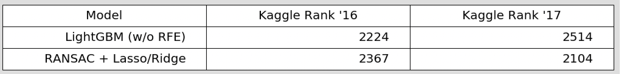
Result Analysis
RANSAC with Lasso/Ridge and LightGBM with variance threshold provided the best overall model for 2016 and 2017. The former performs better for 2016 data. The latter performs better for 2017 data. One may speculate that there may have been more outliers recorded in the 2016 dataset than2017 dataset.
out of 3779 teams total (rank)

Slide 25
Conclusion:
we cannot simply rely on domain knowledge to handle feature selection and should allow the algorithm to automatically select the important features
there is no single good that provides the performance we are very satisfied with. In fact, based on the empirical results above, different combinations of trained models may acquire the overall best outcome.
Other outside influences such as the inflation/deflation in real estate market needs to be considered

Slide 26
Thanks for listening！

